Slide 1

06-binary-search-tree

Slide 2

עץ חיפוש בינארי – Binary Search Tree (BST)
8
Definition: For each node x, the left subtree contains nodes with keys less than x.key, and the right subtree contains nodes with keys greater than x.key. Each subtree must also be a binary search tree.
3
10
תכונות של BST
1
6
14
For every node x in the binary search tree T:
If y is a node in the left subtree of x, then y.key ≤ x.key.
If y is a node in the right subtree of x, then y.key ≥ x.key.
Minimum key: The key of the leftmost node. Maximum key: The key of the rightmost node.
4
7
13

Slide 3
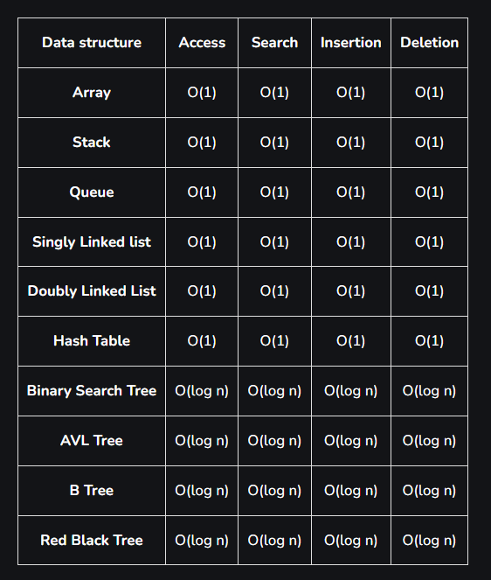
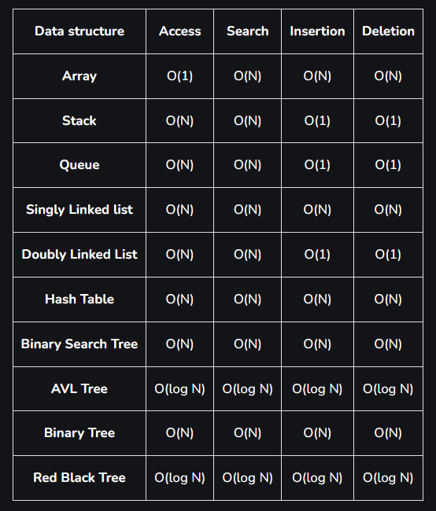
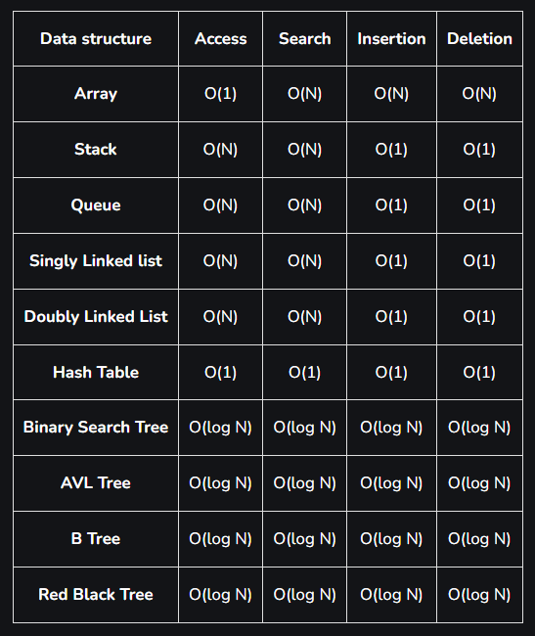
Time complexities of different data structures
Best case time complexity of different data structures for different operations
Worst Case time complexity of different data structures for different operations
The average time complexity of different data structures for different operations

Slide 4
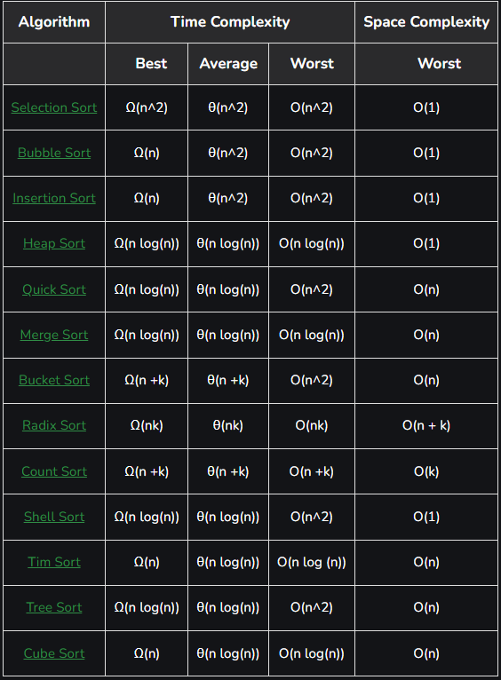
Time Complexities of
all Sorting Algorithms

Slide 5
תרגיל 1
Given a sequence of numbers. In each of the following sequences, construct a binary search tree, starting with an empty tree, and inserting the numbers in the sequence from left to right.
a) 1, 2, 3, 4, 5, 6, 7
b) 4, 2, 1, 3, 6, 5, 7
c) 1, 6, 7, 2, 4, 3, 5
a
1
c
2
b
1
4
3
6
4
2
6
2
7
5
1
3
5
7
4
6
3
5
7

Slide 6
תרגיל 2
Construct two binary search trees from the set of values: {2, 3, 5, 5, 7, 8}.
b
a
5
3
3
7
2
5
2
5
8
5
7
8

Slide 7
מחיקת אלמנט מעץ חיפוש בינארי
There are three possibilities:
For the element being deleted, there are no children.
For the element being deleted, there is one child.
For the element being deleted, there are two children.

Slide 8
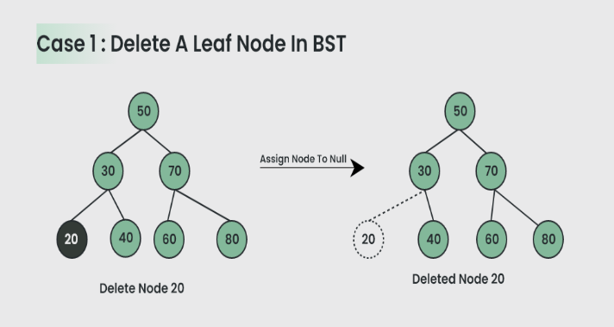
מחיקת אלמנט מעץ חיפוש בינארי

Slide 9
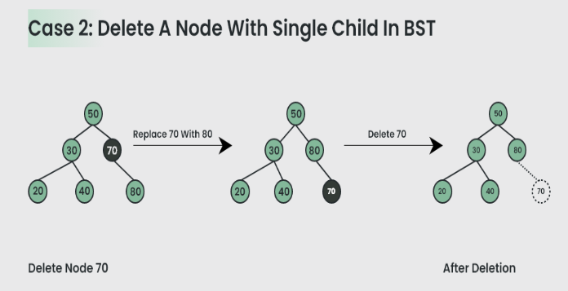
מחיקת אלמנט מעץ חיפוש בינארי

Slide 10
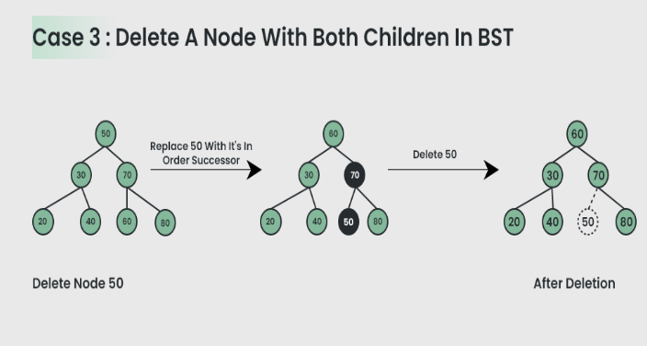
מחיקת אלמנט מעץ חיפוש בינארי

Slide 11
תרגיל 3
Suppose that numbers between 1 and 1000 are stored in a binary search tree, and we want to search for the number 363. Which of the following sequences cannot be sequences of nodes encountered during the search? (Read sequences from left to right).
2, 252, 401, 398, 330, 344, 397, 363
924, 220, 911, 244, 898, 258, 362, 363
925, 202, 911, 240, 912, 245, 363
2, 399, 387, 219, 266, 382, 381, 278, 363
935, 278, 347, 621, 299, 392, 358, 363

Slide 12
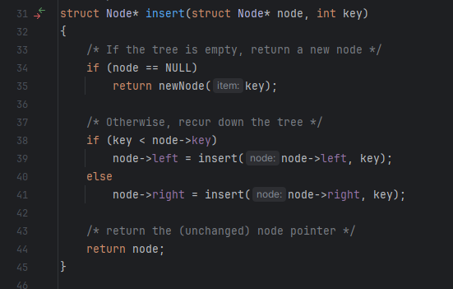
מימוש עץ חיפוש בינארי

Slide 13
תרגיל 4
Write a non-recursive algorithm that takes a binary search tree and a value as input. The algorithm should return true if the value is found in the binary search tree, otherwise it should return false.
function search_in_binary_tree(root, target):
If root is null: // Check if the root is null (empty tree)
return false
current_node = root // Start with the root of the tree
while current_node is not null: // Continue searching until the current node is not null
If current_node.value is equal to target: // Check if the target value is equal to the value in the current node
return true
If target > current_node.value: // If the target is greater than the current node's value, move to the right subtree
current_node = current_node.right
else: // If the target is less than the current node's value, move to the left subtree
current_node = current_node.left
return false // If the loop completes without finding the target, return False

Slide 14
תרגיל 5
Write an algorithm that takes two binary search trees as input and returns true if all the keys found in the first tree are also found in the second tree.
function isBST1inBST2(x, y):
# Base case: If x is NULL, then it is a subtree of y
if x is NULL:
return true
# Check if the key at the current node x is present in the tree rooted at y
is_current_key_present = search_in_binary_tree (y, x.key)
# Recursively check left and right subtrees
return is_current_key_present && isBST1inBST2(x.left, y) && isBST1inBST2(x.right, y)

Slide 15
תרגיל 6
func(x)
while x.left ≠ NULL do
x ← x.left
return x
Write a recursive algorithm that performs the same operation.
function tree_minimum_recursive(x):
# Base case: If the left child of x is NULL, then x is the minimum
if x.left is NULL:
return x
# Recursive case: Call the function on the left child
return tree_minimum_recursive(x.left)

Slide 16
תרגיל 7
Write an algorithm that takes a binary search tree as input and returns the second largest value in the tree.
function max2(T):
x = T.root
if x is NULL or (x.left is NULL and x.right is NULL): # Base case: If the tree is empty or has only one node
return -1
while x.right is not NULL: # Move to the rightmost node
x = x.right
if x.parent is not NULL and x.left is NULL: # Case 1: If x has a parent and no left child
return x.parent.key # Return the parent's key (second maximum)
x = x.left # Move to the leftmost node in the right subtree
while x.right is not NULL:
x = x.right
return x.key # Case 2: Return the key of the leftmost node in the right subtree

Slide 17


